Slide 1
New Distributor
ORIENTATIONS
A Product of
Winners System
for Success (WSS)

Slide 2
It is not about
what you get from this business
It is about
what you become
with the process
Before
After
With
Winners System for Success

Slide 3
What after joining
The only thing you need to do just after joining is
do nothing for next seven days
Do not go out and start speaking to people about the product and business opportunity
For your survival you need to be in
“Intensive Care with Upline” (ICU)

Slide 4
Start it Part Time then you may make it Full Time with up line counsel
Part time good
Full time Best
But Spare time is worst
It is very important
to learn to peruse this business
without disturbing
what are you currently doing

Slide 5
Take a Strong Decision Think this as Multi crore investment
Your dreams/reason/Why is 90% then how to build it is 10%. Your burning desire acts as fuel at the time of doubt and challenges
Your goals are dreams with a date on it.
Understand the Power of written dreams, Visualization & Power of Spoken words
Keep your dreams in front of your eye always
Do it as if your life depend on it
Do not Afraid of big dream

Slide 6
It starts with your Believe
Believe the company, and its marketing plan
Believe Your Up line
Believe in the System
Believe in yourself that you can do it
BELIEVE
BEGIN
BECOME
Remember, You are the company, Your prospect will join you by seeing your believe, trust with the company and with the system

Slide 7
Know the Company
Before joining in any network marketing company you must analyze three things
The company must have crossed at least 15 years in the industry,
You must know the products quality, Need of the hour and repeat purchase
Must analyze its marketing plan. The distribution transparency. Equal opportunity to every one

Slide 8
Know your Products
Here products are the by product. The real product is Opportunity where you are going to sell FREEDOM. We are selling Financial freedom and Time freedom.
However, products plays an important role in building our business
Therefore, it is very important to learn about the products

Slide 9
Know your Support structure
Good news is that you are not alone. We are under the banner of
“Winners System for Success”
WSS is an independent Training & Support system developed by your LOS Leaders Orissa
We shall get the products from the company and we shall get Training from both compny & WSS
Your LOS(Line of Sponsors) will help you get connected with both the system
Company
WSS
Products/
Trainings
LOS
Trainings &
Mentoring
You

Slide 10
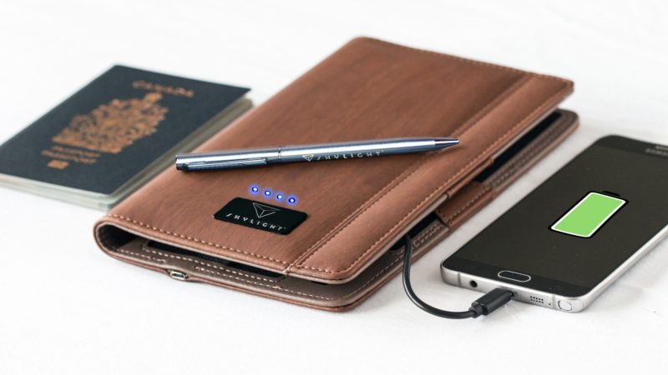
Know your Tools
Forever presentation file/ Power Point Presentation
Company’s support literatures/ book /broachers (PDF)
Audio/Video links, PDF copy of various motivational books
Product Boucher and Price list (PDF)
Organizer and a decent pen
An Android phone with internet

Slide 11
Your First 90 days
Goals
First 30 days
Stay close to your sponsor
Listen to company’s motivational videos
Attend meetings and trainings
Make your list and learn how to approach them/ Qualify /One minute plan/ Appointment
Do at least 4-5 “two-on-one” and one home meeting per week.
Getting Ready
Learn to teach
How to order product
Communication with FLP
How to join new FBOs
Product knowledge for personal
usage and sharing
Plan Presentation/ Marketing Plan
Appointment book
List book
Function book
Goal setting and Goal Card
Ordering Visiting card

Slide 12
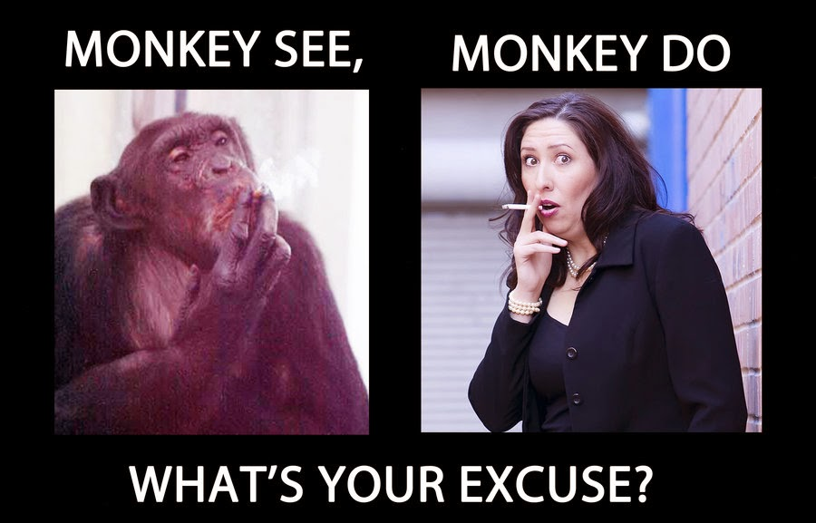
Your First 90 days
Goals
Next 30 days
Practice what did you learn
Rehearse Prospecting/The Pre-approach/appointment
Arrange Home meeting and you show the plan in front of your up line. Just copy your sponsor
Listen and re listen Success stories
Attend trainings
Last 30 Days
Do every thing yourself
Do “one-on-one” or “two on one” yourself
Learn how to build Sponsoring Pipe line yourself
Counsel weekly

Slide 13
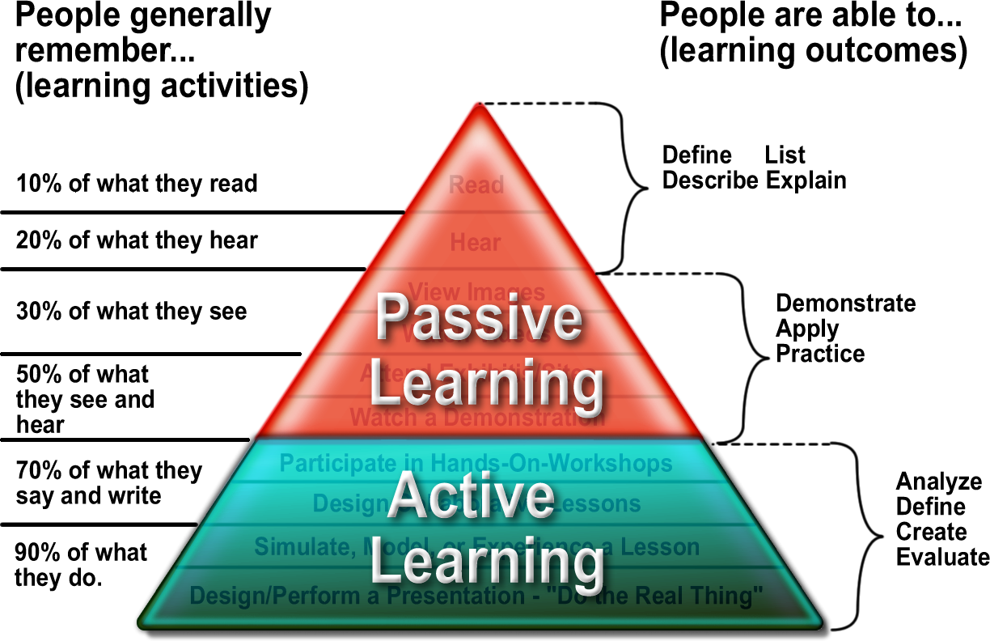
Practice 6 Basics with your up line during working during first 90 days working pattern
The 6 Basics
Dream
List
The Pre-approach
Bridging/Qualify
One minute plan
Primary objection handling
Appointment
Plan show
Follow up
The Commitment
Business Volume

Slide 14
Action Plan
Set the Trend of doing 4cc Active
business every month and duplicate it
Be a Trend Setter on the way to build your active 4cc Business
Share
Sponsor
15-30 plans how p.m.
3-4 Customers
2-4 New Joining
Make at least one person 15 planner
11
Program
Starts at 1st
& ends at 30th of every month
BV
80%
Use
20%
New cust. 1
New Cust.2
New Cust. 3
Share
Sponsor
BV
11
Use
New Customers with BV
New joining must be associated with product purchase
You should promote the required quantity of BV to boost your next promotion
Focus on some one who is going to duplicate your in creating business Volume

Slide 15
Focus on Meetings
Promote meetings as the most important function of your life
Learn to book a meeting from a meeting
Personal Home meeting is the life blood of this business.
Use meetings to teach your group.
More and more ‘one-on-one’ will feed your Home meetings. More and more Home meetings will feed your Weekly meeting & monthly seminars
Count your group size sitting right in a meeting

Slide 16
Be a best version of yourself
No body can make more money beyond some one’s personality
Your job is to build people and people will build the business
Be a magnet so that people will get attracted towards you.
Develop CORE qualities of a Leader
Remember people do not join the company they join with you.
Listening
Smile
Communication
Positive Attitude
Dress Code
Is Your Personality stopping you from SUCCESS

Slide 17
Take Responsibility
You are the creator of your own destiny
No body is responsible for your success.
Neither your up line nor your company is responsible for your success in flp.
Remember, it is your business,
you need to take charge of your business like showing plan, conducting home meeting, Product knowledge and Marketing plan as soon as possible.

Slide 18
A Few statutory Laws The Five agreements
Let GO the 9 in 10 who won’t buy.
No-1 Let GO the 9 in 10 who won’t buy / join
No-2 Do not sound like a sales man, Sound like an advisor
No-3 Get rid of following terms:
No-4 Connect with the Hot buttons: Use words and parses that attracts your prospect. And again connect to your prospect’s hot button by giving solution oriented approach by finding customer’s NEED
No-5 Do it over & over & over & over & over again…& again….
Patients
Medicines
Herbal Medicines
Natural Medicines
Cure
Client/Customer
Remedy/Alternative
Herbal Supplements
Food Supplements
Solution/Remedy

Slide 19
Five Rules to success
5. Analyse the Results
Review your progress daily
Counsel weekly
each action will product result Y or N both resu
Both are good
Analyse them
1. Understanding
Company policy
How to be successful
WWW.fbosite.foreverliving.com
Myforeverlivingapp, aloestore.in
Become a sponge
Ri;e-5
Ri;e-1
Burning Desire
Ri;e-2
2. Belief
Ri;e-4
Network Marketing
Products
Company
Yourself
Become the product
4. Massive Action Plan
15+ Plan show per month
Sponsoring every month
Retailing
Teaching others
Leadership
Do not neglate the one you have sponsored Always help and Nurture
Make them better then U
Rule-3
3. Committment
Use 4 gel per family
Time: 7/8 hours per week for One year
Attend every thing
Your group
Your Family
Do the right thing then doing it right

Slide 20
The Road to Success.
Many people will say no to this business. Treat
“No = Next One”
View Your FLP Business as a Long Term Proposition
See That Your Business Will Grow Through:
Careful Planning
Goal Setting
Breaking Tasks into Manageable Steps

Slide 21
Do not work without setting goal
You need to remember two things in network marketing business
Goal setting on the first day of the month
Closing: You must chase for your goals till the last hour of the month
Rules:
Goal should not be too big. It must be achievable.
Must have a Working plan to go for it
Goals must be written & should be in front of your eyes always
Goals must have a dead line to follow
It must be associated with a strong reason
Goal should be reviewed with you active and growing up line

Slide 22
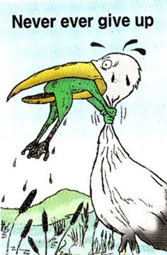
Your dreams Must be real & must be Bigger then your fears
Build it once
Build it Right
Build it Big
Build it to retire
young, Rich and worry free
Thank you

