Slide 1
Dream Builder
Width Builder
Depth Builder
The
Success
Relationship Builder
Vital sign builder
Duplication
Principles
Personal growth
Volume Builder
Winners System For Success

Slide 2
The
Success
Principles
Dream Builder: Build your Dream and take care of your down line’s dream
Width Builder: Width is stability. Keep adding new front lines at a regular basis
Depth Builder: Depth is profitability. Personally take charge of your depth
Vital sign builder: Among many meeting strength is the no-1 vital sign which will take care others.
Volume Builder: Stay focused on Product movement on your every step of working on sponsoring pipe line
Relationship builder: Build relation and build business
Personal Growth: One can not make more money beyond his personality
Duplication: Do not do any thing which wouldn’t duplicate

Slide 3
Dream Builder
1
Dreams are everything.
The bigger the dreams the bigger the achievements.
You need to take care of your dream as well as the dreams of your down line leaders.
Find out what others want and help them to achieve it.
Attach dreams yours and others to the point of Focus Board.
Focus on Rewards not on obstacles.
Dreams are free and dreams are powerful……
but be careful dreams can be stolen.
Dreams are fuel… but you still need a
A GOAL- A PLAN- & EFFORT

Slide 4
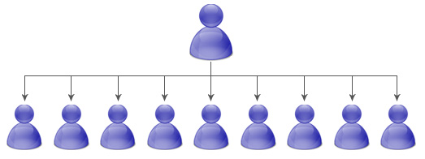
Width Builder
2
Front lines
Personally sponsor 30 front line FBOs fast ( 6-8 month) there after sponsor at least 2 front lines per month.
Build a base to create options to work with right people.
Width is profitability.
Add new front lines regularly to give you a posture and to set the proper example
Remember
More width = More Depth
Depth Driving

Slide 5
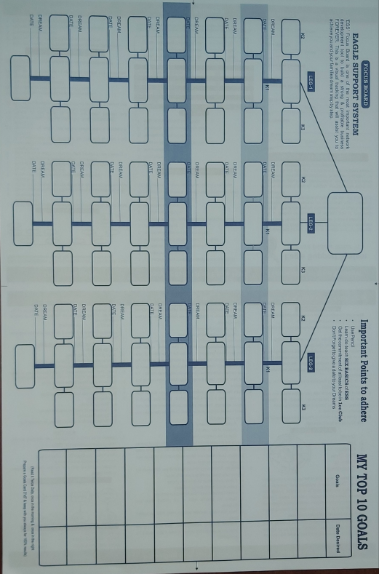
Depth Builder
3
Take charge to build depth by showing more plans and conducting Home meetings yourself. Use Focus Board to keep track of your Depth.
Focus on depth beyond your profit zone. Commit to work at least 4th to 5th depth in each of your active legs.
You need to drive your depth with the power players the CORE leaders. Check your up-line mentor about right depth.
Include only CORE leaders into the FOCUS BOARD. Personally take charge of the depth until one becomes independent
Remember in many organization 80% of the work is done by 20% of the people. So you should spend your 80% of your time with the 20% of the FBOs.

Slide 6
Volume Builder
4
Money is the biggest motivational factor in Network Marketing business. Along with all other activities creating volume is one of the most important factors. Volume will come from the product movements only.
Be the first person to participate in creating volume with 4cc commitment
Teach others to duplicate and create the bigger volume.
If you need more milk then bring more cows. Recruit more people into your business and your Productivity/Volume will increase.
Business
Volume
Share the Products
Sponsor Distributors
Use the Products

Slide 7
Vital Sign builder
5
Sl.No. | Particulars | Eagle | Silver Eagle | Golden Eagle
1 | Front Line | 10 | 20 | 30
2 | Bonus Legs | 3 | 4 | 5
3 | 15 planner (16K BV) | 3 | 4 | 5
4 | 30 planner (60K BV) | 3 | 10 | 15
5 | Clients | 15 | 15 | 15
6 | New joining | 6 | 15 | 20
7 | Depth in Focus Board | 2 | 3 | 4
8 | Group Size | 30 | 100 | 150
9 | WWT (Mly) | 10 | 30 | 50
10 | Success Day (Qly) | 5 | 15 | 25
Vital sign figures are typical example on the basis of WSS working pattern
If you Want to enjoy life time residual income then build your business according to Vital Signs
Build your vital signs your business volume has to come automtically
Be Worthy of Pin/Position
It may very from place to place on different working pattern of the leaders

Slide 8
Relationship Builder
6
Build relation build business
Develop friendship and Key relationships with a minimum of 4 to 5 people in the depth.
Look for people who follow the System, are loyal, teachable, goal oriented and are CORE
Remember you are the coach, the example, the friend, the encourager, not the BOSS. Earn respect, friendship, loyalty through service, performance and character.
One may leave a business but not a friend.

Slide 9
Personal growth
7
It is truly said that a person can’t make more money than his personality.
Start doing right things when some is not watching you. Be an honest. Ethical & a good human being inside out
Be a CORE person. Follow all the 7 attributes of CORE
Dress for Success. To be successful you should look successful.
Punctuality: Come early and leave late in all the major WSS and FLP functions
This is a business of words and values. So always keep word always.
Be a product of your products
Always wear Smile. Smile is a curve which sets everything straight.

Slide 10
Duplication
8
If 1000 people can’t duplicate do not do it when your group is 10
The best thing is that it duplicates and the worst thing is that it duplicates. Remember wrong thing duplicates faster than the right thing.
Whatever you do you need to ask yourself can others duplicate it ? Do only simple things that can be copy by others.
Duplicate winning attitude, ethics, habits, team work and volume.
Follow the WSS system without changing a single word. Be the first person to follow. Your action speaks louder than your words.
Success on personal credibility would not duplicates
If won’t duplicates, don’t do it.
Duplicate do not negotiate.

Slide 11
Build it once,
Build it big,
Build it right
Build it to retire young, Rich, and worry free.

