Slide 1
Core habits
The
Winners system for success

Slide 2
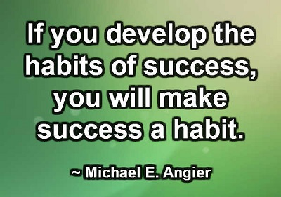
The
Core
habits
You are either CORE or not CORE, you can’t be in between. You need to follow all the 7 attributes of CORE habits by 100%
Business
Building
Habits
Alien your thoughts, Words and Deeds. Be submissive to the System & LOS
Use the products
Share the products
Show The Plan
Attend All Meetings
Learn every day and be teachable
Be a team Player: (i) Edification (ii) Counseling (iii) No cross lining (iv) Cardinal rules: Do not play with someone’s money, honey & ego
Business Growth
Business
Keeping
Habits

Slide 3
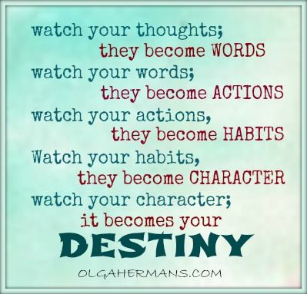
1. Alien your thoughts, words & deeds
Power of thought: Remember our brain is a recording machine. What ever you are thinking positive or negative it is being recorded your subconscious mind works constantly without knowing what is good or what is bad. And it will tune your words and deeds
Power of Spoken words : it also tunes your brain hence it reflects on your results.
Hence submit to your up line mentor with at least one year commitment

Slide 4
2. Use the Products
Be a 100% Product user: Products are the back bone of our organisation. Start using all the products that you are buying from the market. Use the product as a business owner. Create your own story.
Learn about the products: Attend product trainings. The best way to know the product is start using the products.
Product Use will create a strong belief: Be a product of the products.
Product usage adds to Business Volume: You be the first person in creating Business Volume of your multi million $ business
Know that it Duplicates.

Slide 5
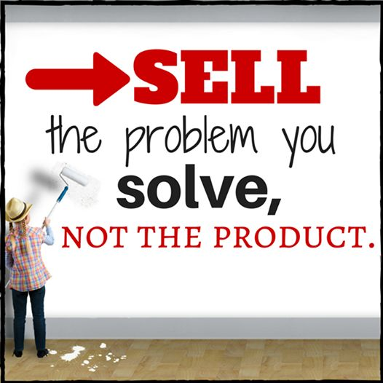
3. Share the products
FLP gives you the opportunity to become the Brand Ambassador of its world class products.
Sharing is automatic. When you use the products feel the benefits and you will be tempted to talk about it
Sharing can be done by two different approaches
Product to business ( it should be 20%)
Business to products (It should be 80%)
Since 90% of your prospect will say No to the business so they may say yes to the Products
Products are one of the important TOOL in building your Business.
Remember we are going to sell the Freedom

Slide 6
4. Show The Plan
Show The Plan is like opening your shop
Plan show is about explaining 3 “P” of the company
P - Profile of the Company
P - Product of the Company
P - Plan of the Company
There are 4 types of plan show one need to master
Abbreviated plan show, (“1st Look”) can be done “one/Two on one”,
BOPP: 45 minutes -1 hour plan show, the “2nd Look” home/zoom meeting
Weekly Open Plan show: (3rd Look)
Need base plan (4th Look) show during Follow up.
The Basic ingredients of plan show
KISS (Keep It Simple & Short)
Dress up for Success even on zoom
Excitement, Wear smile
Need base Product information
Call for action (joining/product ordering)
Fix a next follow up date.,

Slide 7
5. Attend All meetings & Trainings
It is rightly said that Network marketing is based on meetings and seminars.
Use meetings to teach your group.
Count your group size sitting right in a meeting whether it is in a Hotel/ in a Venue or in Zoom Webinar.
Meeting is about association of positive/like minded people.
The very purpose of the meeting is to promote the next meeting.

Slide 8
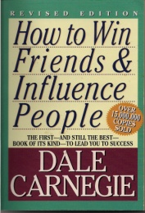
6. Learn every day and be teachable
Faster you Learn Faster you Earn.
Make a habit of watching the videos. Connect yourself with the Webinars/Zoominars on a daily basis.
Leaders are readers. Learn from the mistakes from others. Spend at least 30 minutes reading Recommended books
Learn from your up-line leaders
Make a commitment of life long learning. Always make a habit of taking notes.

Slide 9
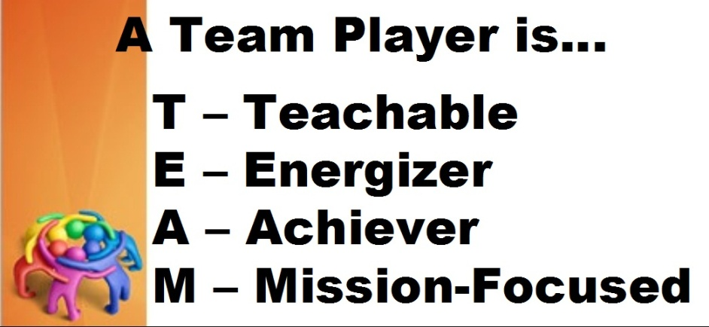
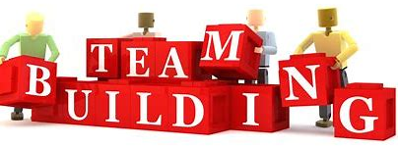
7. Be a Team Player
Together Everyone Achieve More
Edification: it is about lifting people up
Counselling: It is a weekly process where your up line can guide you step by step while building your business in a right way
NO Cross lining: Not to hamper others business.
Cardinal Rules : Not to play with any one’s Money, honey & Ego.

Slide 10
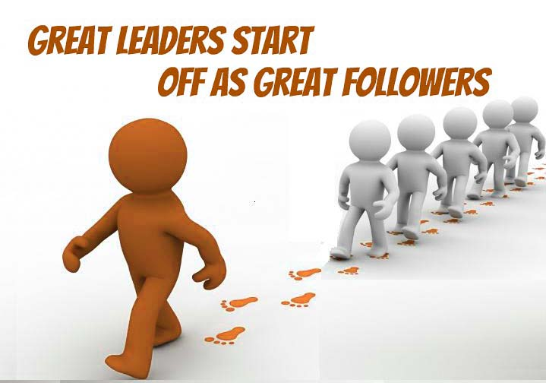
YOUR TEAM WILL BE the ultimate reflection of your leadership
If You can build
People
&
People can build
the Business
Thank you

